Slide 1
Introduction to Unsupervised Learning

Slide 2
Learning Goals
In this section, we will cover:
- Unsupervised Learning
- Clustering
- Dimension Reduction

Slide 3
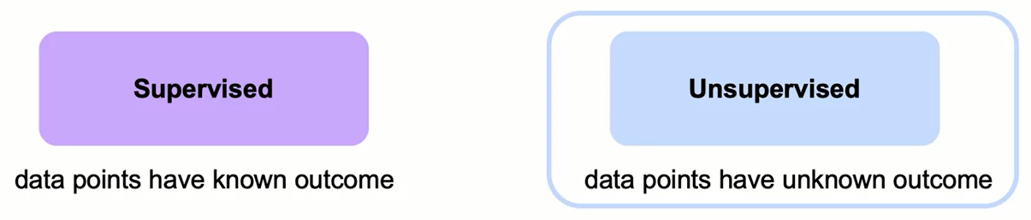
Types of Machine Learning

Slide 4
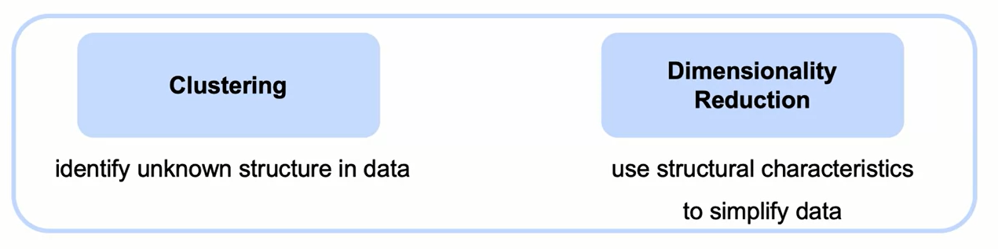
Types of Unsupervised Learning

Slide 5
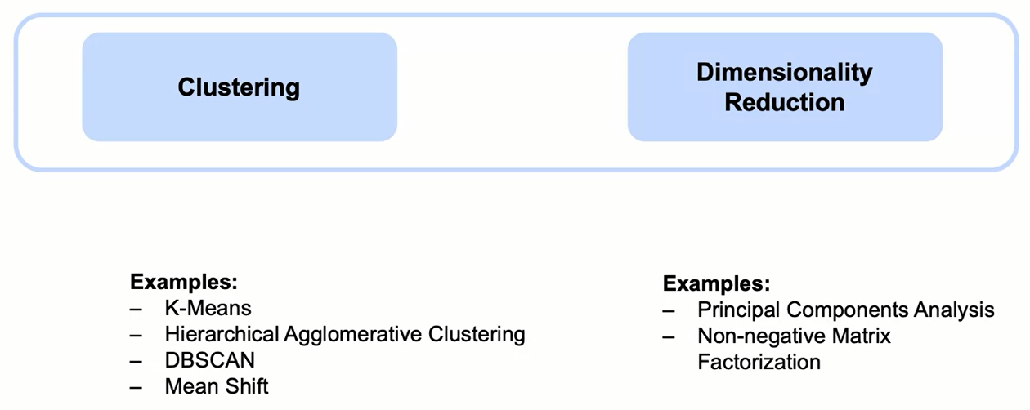
Types of Unsupervised Learning

Slide 6
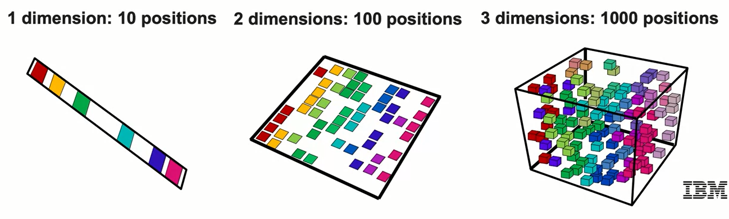
Curse of Dimensionality
- In theory, increasing features should improve performance.
- In practice, too many features leads to worse performance.
- Number of training examples required increases exponentially with dimensionality.

Slide 7
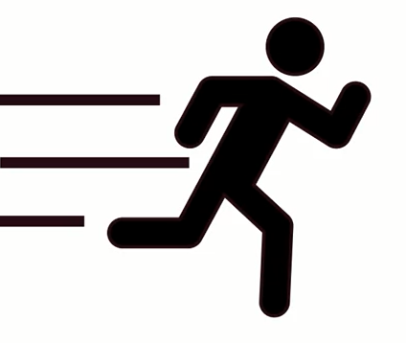
Curse of Dimensionality: Churn Example
The Curse of Dimensionality comes up often in applications.
Consider the customer churn example from earlier.
The original dataset has 54 columns:
- Some, like 'Age', 'Under 30', and 'Senior Citizen' are closely related.
- Others (Latitude for example) are essentially duplicated.
- Even if we remove duplicates and non-numeric columns, the curse of dimensionality applies
Clustering can help identify groups of similar customers
Dimensionality reduction can improve both the performance and interpretability of this grouping

Slide 8
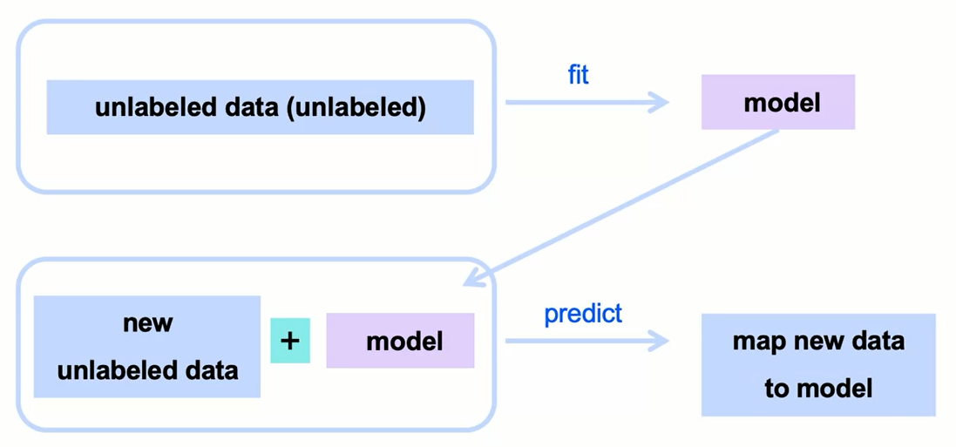
Unsupervised Learning Overview

Slide 9
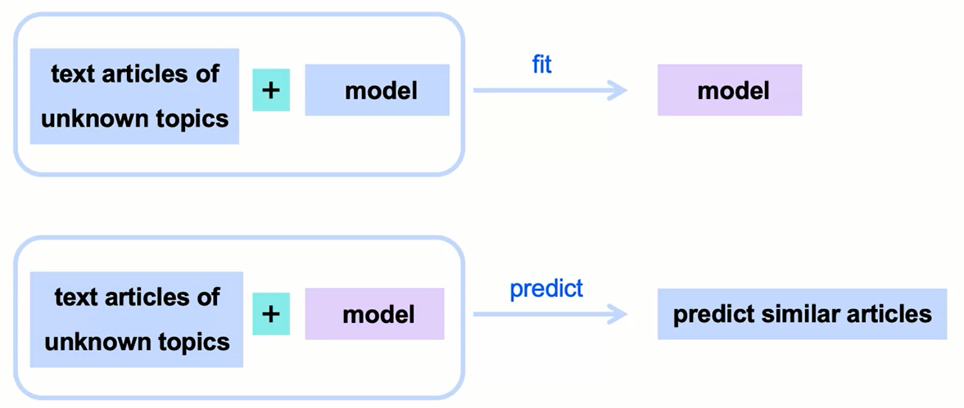
Clustering Example:
Group News Articles by Topics

Slide 10
Common Clustering Use Cases
Classification
Anomaly detection
Customer segmentation
Improve supervised learning

Slide 11
Common Clustering Use Cases
Classification - leverage patterns in unlabeled data
Examples:
Unlabeled data
Spam filter
Groups of product reviews

Slide 12
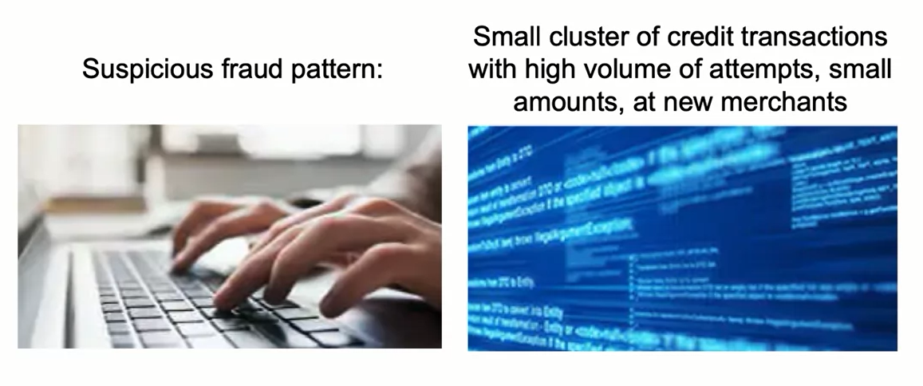
Common Clustering Use Cases
Anomaly detection
Example: fraudulent transactions

Slide 13
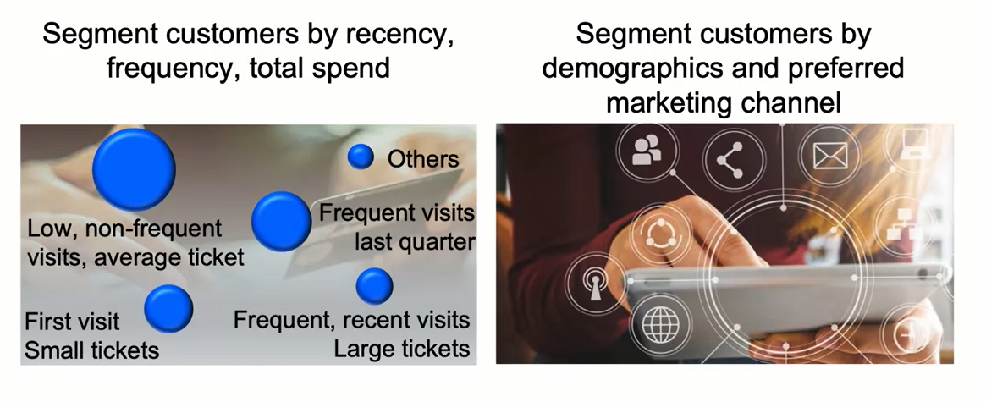
Common Clustering Use Cases
Customer segmentation
Examples:

Slide 14
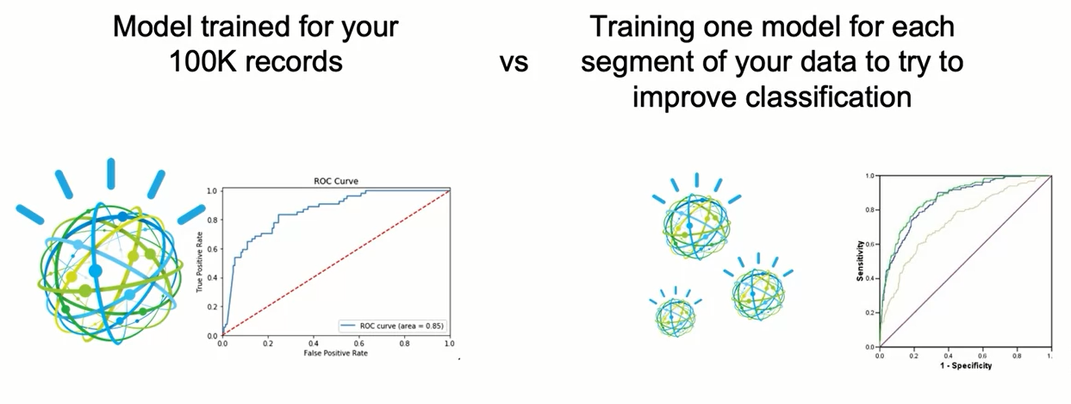
Common Clustering Use Cases
Improve supervised learning
Example: Logistic regression per cluster

Slide 15
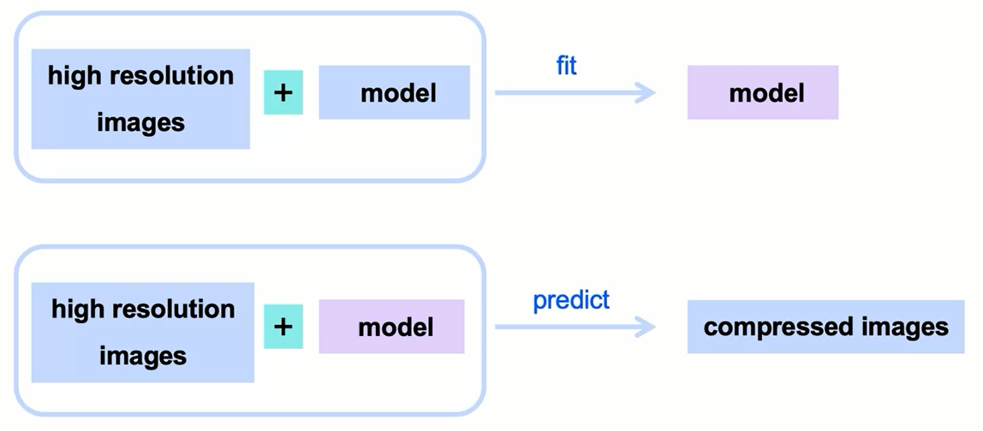
Common Dimension Reduction Use Cases

Slide 16
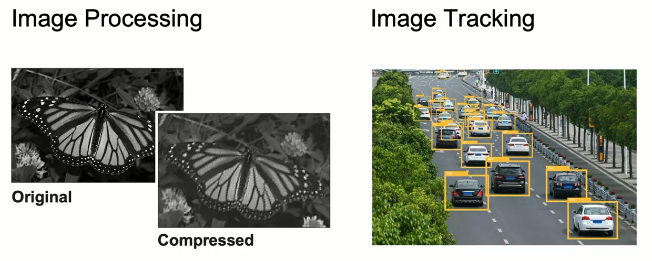
Common Dimension Reduction Use Cases

Slide 17
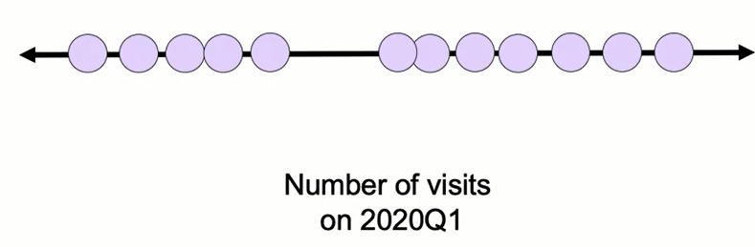
Introduction to Clustering
Users of a web application:
- One feature (visits)

Slide 18
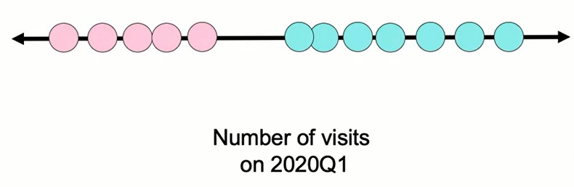
Introduction to Clustering
Users of a web application:
- One feature (visits)
- Two clusters

Slide 19

Introduction to Clustering
Users of a web application:
- One feature (visits)
- Three clusters

Slide 20
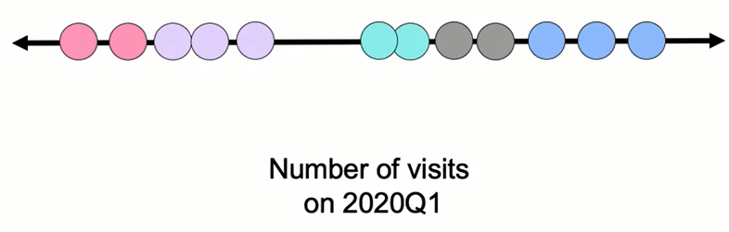
Introduction to Clustering
Users of a web application:
- One feature (visits)
- Five clusters

Slide 21
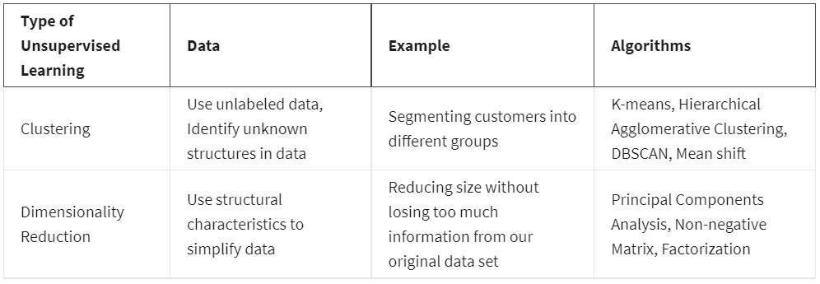
Summary
Unsupervised Learning Algorithms
Unsupervised algorithms are relevant when we don’t have an outcome or labeled variable we are trying to predict.
They are helpful to find structures within our data set and when we want to partition our data set into smaller pieces.
Types of Unsupervised Learning:

Slide 22
Summary
The Curse of Dimensionality
In theory, a large number of features should improve performance. As models have more data to learn from, they should be more successful. But in practice, too many features lead to worse performance. There are several reasons why too many features end up leading to worse performance. If you have too many features, several things can be wrong, for example:
Some features can be spurious correlations, which means they correlate into the data set but not outside your data set, as long as new data comes in.
Too many features create more noise than signal.
Algorithms find it hard to sort through non-meaningful features if you have too many features.
The number of training examples required increases exponentially with dimensionality.
Higher dimensions slows performance.
Larger data sets are computationally more expensive.
Higher incidence of outliers.

Slide 23
Summary
The Curse of Dimensionality
To fix these problems in real life, it's best to reduce the dimension of the data set.
Similar to feature selection, you can use Unsupervised Machine Learning models such as Principal Components Analysis.
Common uses of clustering cases in the real world
Anomaly detection
Example: Fraudulent transactions.
Suspicious fraud patterns such as small clusters of credit card transactions with high volume of attempts, small amounts, for new merchants. This creates a new cluster and this is presented as an anomaly so perhaps there’s fraudulent transactions happening.

Slide 24
Summary
Common uses of clustering cases in the real world
Customer segmentation
You could segment the customers by recency, frequency, and average amount of visits in the last 3 months. Another common type of segmentation is by demographic and the level of engagement, for example, single costumers, new parents, empty nesters, etc. And the combinations of each with the preferred marketing channel, so you can use these insights for future marketing campaigns.
Improve supervised learning
You can perform a Logistic regression for each cluster. This means training one model for each segment of your data to try to improve the classification.

Slide 25
Summary
Common uses of Dimension Reduction in the real world
Turn high-resolution images into compressed images
This means to come to a reduced, more compact version of those images, so they can still contain most of the data that can tell us what the image is about.
Image tracking
Reduce the noise to the primary factors that are relevant in a video capture. The benefits of reducing the data set can greatly speed up the computational efficiency of the detection algorithms.

Slide 26
Learning Recap
In this section, we covered:
- Unsupervised Learning
- Clustering
- Dimension Reduction

